Slide 1


Making work visible
Improving productivity and collaboration

Slide 2
The problems with invisible work
Emotional Exhaustion: Constantly juggling multiple responsibilities without recognition or support can lead to emotional exhaustion.
Burnout: Unpaid caretaking roles, also known as “mental load,” contribute to extreme stress and chronic illness. Women, who often do most of the unpaid care work, experience higher rates of burnout.
Diminished Self-Worth: When invisible work goes unnoticed, it can erode an individual’s sense of self-worth and identity.
Blurred Boundaries: Invisible work blurs the boundaries between work and personal life, impacting job satisfaction and engagement.
Strained Relationships: The strain of managing invisible tasks can affect personal relationships and overall well-being.
Making Work Visible Book Review and Q&A with Dominica DeGrandis - InfoQ

Slide 3
The problems with invisible work
Hidden bottlenecks: invisible tasks create delays that are not apparent until they become a critical issue
Lack of accountability: If the work is not known it is hard to hold people accountable for completing tasks
Prioritization issues: hard to prioritize, potentially leading to important tasks being neglected
Reduced team morale: efforts go un-noticed
Inefficiencies: duplication in effort, missed deadlines, wasted time and resources

Slide 4

What are some examples of invisible work?

Slide 5
Types of invisible work
Ad-hoc requests: tasks requested informally that don't get tracked (hallway convo's, teams msg, etc.)
Untracked communication: time spend on emails, msgs, team meetings
Meeting preparation and follow-ups: preparing for meetings, taking notes, following up on action items
Support and mentorship: Helping colleagues, answering questions, providing guidance
Admin duties: timesheets, updating software, task planning

Slide 6
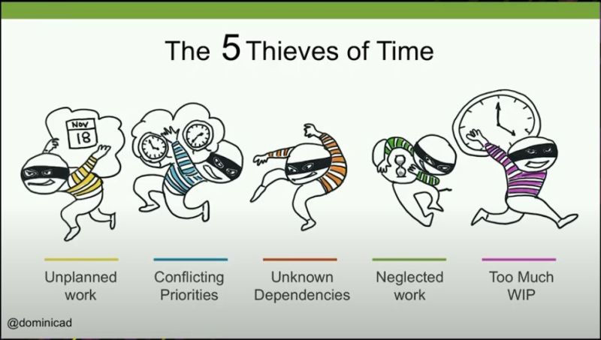
Work unseen is work uncontrolled
Invisible work feeds directly into common productivity issues known as the five-time thieves.

Slide 7

Too much work in progress (WIP)
Untracked tasks = hidden bottlenecks
Invisible tasks often increase the amount of work-in-progress
Teams take on additional untracked tasks, leading to overcommitment
Ex: a developer is working on several visible tasks but is also handling urgent, untracked bug fixes. This increases their actual WIP, causing delays and inefficiencies.

Slide 8

Unknown Dependencies
Dependencies are often not documented or tracked, making them invisible
Untracked dependencies can lead to delays or rework
Ex: a team member starts a task only to realize it depends on a colleague’s untracked work i.e. firewall change, configuration change, etc.

Slide 9

Unplanned Work
Work that is not visible to the team
Work that disrupts planned tasks and priorities
Ex: An urgent request comes in and is handled informally without being added to the task board, leading to disruption of planned activities and a lack of awareness about the additional workload

Slide 10

Conflicting Priorities
When work is not visible, it’s challenging to understand and manage priorities effectively
Ex: A manager assigns a high-priority task, unaware that the team is already swamped with invisible, high-priority ad-hoc requests, resulting in conflicting priorities

Slide 11

Neglected Work
Tasks that aren’t tracked or made visible are often neglected, leading to incomplete work and wasted effort.
Ex: Routine maintenance tasks not tracked and hence get neglected until they cause major problems, leading to a rush to address the neglected work.

Slide 12

Visualizing the work

Slide 13

Take aways
Contribute to a common view
Discuss the items openly
Regularly review and adjust
Update often
Engage the entire team
Want to learn more?

